Slide 1
CHAPTER 3
Statement Forms
【See Chap.4 in the textbook】

Slide 2

3.1 Simple statements
Which perform some action or used to accomplish a variety of tasks.
N1 = GetInteger();
read in data from the user.
total = n1 + n2;
compute new values.
printf(“Thde total is %d\n”, total);
display information .
SIMPLE STATEMENT RULE:
A simple statement consists of an expression followed by a semicolon.
expression;

Slide 3


n1 + n2;
a legal statement, but not a useful statement.
total = 0;
the equal sign used for assignment is simple a binary operator, just like + or /. Its left operand must be a variable name.
Simple statements in C are typically assignments (including the shorthand assignments and increment/decrement operators) or calls to functions, such as printf, that perform some useful operation.
A function call is a legal expression.

Slide 4


If an assignment is an expression, then that expression must itself have a value.
Moreover, if an assignment produces a value, it must also be possible to embed that assignment in some more complicated expression.
Embedded assignments
Are the parentheses required?
(x = 6) + (x = 7)
has the effect of setting x to 6 and y to 7, which makes the value of the expression as a whole 13.
Multiple assignments
n1 = n2 = n3 = 0;
C evaluates assignment operators from right to left. The statement is therefore equivalent to
n1 = (n2 = (n3 = 0));

Slide 5


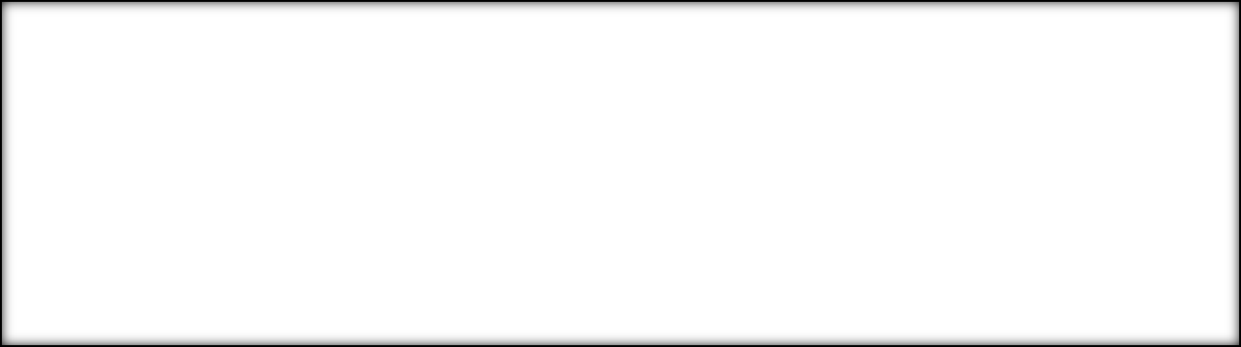
d = i = 1.5;
If the variable d has been declared as a double and the variable i has been declared as an int.
This statement is likely to confuse the reader.
Blocks
{
statement₁
statement₂
statement₃
…
statement_{n}
}
To specify that a sequence of statements is part of a coherent unit, you can assemble those statements into a block which are sometimes referred to as compound statements.
There is never a semicolon after the closing brace.
The statement in the interior of a block are usually indented relative to the enclosing context.

Slide 6
TABLE A-1 Complete precedence table for C operators
Operator |  |  |  |  |  |  | Associativity
( ) | [ ] | -> | . |  |  |  |  |  | left
unary operators: - |  |  | ++ -- | ! & | * ~ | (type) | sizeof |  | right
* | / | % |  |  |  |  |  |  | left
+ | - |  |  |  |  |  |  |  | left
<< | >> |  |  |  |  |  |  |  | left
< | <= | > | >= |  |  |  |  |  | left
== | != |  |  |  |  |  |  |  | left
& |  |  |  |  |  |  |  |  | left
^ |  |  |  |  |  |  |  |  | left
| |  |  |  |  |  |  |  |  | left
&& |  |  |  |  |  |  |  |  | left
|| |  |  |  |  |  |  |  |  | left
?: |  |  |  |  |  |  |  |  | right
= | op= |  |  |  |  |  |  |  | right
, |  |  |  |  |  |  |  |  | left

Slide 7
3.2 Control statements which affect the way in which other statements are executed.
Control statements in C fall into two basic classes:
1. Conditionals. In solving problems, you will often need to choose between two or more independent paths in a program, depending on the result of some conditional test. In C, there are two conditional statement forms: the if statement and the switch statement.
2. Iteration. as you start to work with problems that involve more than a few data items, your programs will often need to repeat an operation a specified number of times or as long as a certain condition holds. In C, the control statements used as the basis for most iteration are the while statement as the for statement.

Slide 8
3.3 Boolean data
This type of data—for which the only legal values are true and false.
C does not define such a type. The genlib library defines a special type called bool. It also defines the constant names TURE and FALSE.
C defines several operators that work with Boolean values. These operators comprise two major classes, relational operators and logical operators.

Slide 9



Relational operators
> Greater than
< Less than
>= Greater than or equal to
<= Less than or equal to
== Equal
!= Not equal
if(x = 0)……
This is incorrect.
The correct test is:
The relational operators take atomic values of any type and produce Boolean results.
if(x == 0)……
The relational operators can only be used to compare atomic data. For example, integers, floating-point numbers, Boolean values, and characters. Strings are not atomic.

Slide 10
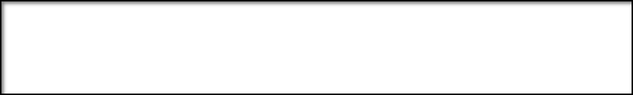



Logical operators
! Logical not (TRUE if the following operand is FALSE)
&& Logical and (TRUE if both operands are TRUE)
|| Logical or (TRUE if either or both operands are TRUE)
precedence
The logical operators take Boolean operands and combine them to form other Boolean values.
p | q | p&&q | p||q | !p
FALSE | FALSE | FALSE | FALSE | TRUE
FALSE | TRUE | FALSE | TRUE
TRUE | FALSE | FALSE | TRUE | FALSE
TRUE | TRUE | TRUE | TRUE

Slide 11

The only common case that seems to cause confusion is when the ! or != operator comes up in conjunction with && or ||.
For example, suppose you wanted to express the idea “x is not equal to either 2 or 3” as a part of a program.
if(x != 2 || X != 3)……
This test is incorrect because it’s always succeed.
To fix this problem, you need to refine your understanding of the English expression. That is, you want the test in the if statement to succeed whenever ―it is not the case that either x is 2 or x is 3.
If(!(x == 2 || X == 3))……
If(x != 2 && X != 3)……
De Morgan’s laws:
!(p || q) is equivalent to !p && !q
!(p && q) is equivalent to !p || !q

Slide 12
Another common mistake comes from forgetting to use the appropriate logical connective when combining several relational tests.
if( 1 < x < 10)……
It is not meaningful in C.
You need to indicate both conditions explicitly, as follows:
if( 1 < x && x < 10)……

Slide 13
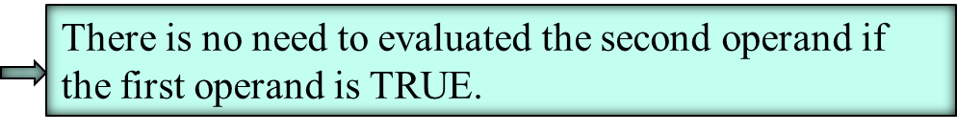

Short-circuit evaluation
Whenever a C program evaluates any expression of the form
exp1 && exp2
or
exp1 || exp2
the individual subexpressions are always evaluated from left to right, and evaluation ends as soon as the answer can be determined.
Flags
A Boolean variable as a flag can be used in your program to record whether or not you are finished with some phase of the operation.
bool done;
……
done = (itemsRemaining == 0);

Slide 14


Avoiding redundancy in Boolean expressions
if(itemsRemaining == 0){
done == TRUE;
}else {
done = FALSE;
}
These lines are a highly inefficient way to achiever the desired result.
To test whether done has the value TREU:
if(done)……
and not
if(done == TRUE)……

Slide 15
An example of Boolean calculation
Suppose you have been asked to write a program that reads in a year and determines whether that year is a leap year.
In order to be a leap year, one of the following conditions must hold:
◻ The year is divisible by 4 but not divisible by 100, or
◻ The year is divisible by 400.
The Boolean expression:
((Y % 4 == 0) && (y % 100 != 0)) || (y % 400 ==0)
Precedence:
% == != && ||
===========➔
Y % 4 == 0 && y % 100 != 0 || y % 400 ==0

Slide 16
An example of Boolean calculation
FIGURE 3-1 Main program from leapyear.c
main()
{
int year;
bool isLeapyear;
printf(“Program to determine whether a year is a leap year.\n”);
printf(“What year? “);
year = GetInteger();
isLeapyear = ((year %4 == 0) && (year %100 != 0)) || (year % 400 == 0);
if (isLeapYear){
printf(“%d is a leap year.\n”, year);
} else {
printf(“%d is not a leap year.\n” year);
}
}

Slide 17


3.4 The if statements
if(condition) statement
if(condition) statement₁ else statement₂
condition is a Boolean-valued expression. statement can be either simple statements or blocks.
if (entry < 0 && balance < 0) {
printf(“This check bonces. $10 fee deducted.\n”);
balance -= 10;
}

Slide 18


FIGURE 3-2 Main program from oddeven.c
main()
{
int n;
printf(“Program to classify a number as even or odd.\n’);
printf(“n = ? “);
n = GerInteger();
if (n % 2 == 0) {
printf(“That number is even.\n”);
} else {
printf(“That number is odd.\n”);
}
}
IF / ELSE
BLOCKING
RULE
For any if statement that (1) requires more than a single line or (2) requires an else clause, always use curly braces to enclose in a separate block the statements under the control of the if statement.

Slide 19

The if statement appears only in one of the following four forms:
SYNTAX for single line if statement
SYNTAX for multilline if statements
if (condition) statement;
if (condition) {
statements;
}
SYNTAX for if/else statements
SYNTAX for cascading if statements
if (condition) {
statements_{T};
}
else {
statements_{F};
}
if (condition₁) {
statements₁
} else if (condition₂) {
statements₂
. . . more else/if conditions . . .
} else {
statements_{none}
}

Slide 20
FIGURE 3-3 Main program from signtest.c
main()
{
int n;
printf(“Program to classify a number by its sign\n”);
printf(“n = ? “);
n = GetInteger();
if (n > 0) {
printf(“That number is positive.\n”);
} else if (n == 0) {
printf(“That number is zero.\n”)’;
} else {
printf(“That number is negative.\n”);
}
}

Slide 21

The ?: operator
(condition) ? expression₁ : expression₂
if (condition) {
value = expression₁ ;
} else {
value = expression₂ ;
}
For example:
max = (x>y) ? x : y ;
For example:
printf(“%d items found.\n”, nItems) ;
printf(“%d item%s found.\n”, nItems, (nItems>1)?”s”:””);

Slide 22



3.5 The switch statement
The switch statement provides a convenient syntax for choosing among a set of mutually exclusive cases.
SYNTAX for the switch statements
switch ( expression ) {
case c₁:
statement₁
break;
case c₂:
statements₂
break;
. . . more case clauses . . .
default:
statement_{def}
break;
}
When the program executes a switch statement, it begins by evaluating expression, which produces an integer-like value.
It then looks for a case clause that matches expression. If expression is equal to c₂, it would choose the second clause.
It executes the statement₂ in the case clause until it reaches the break statement, which should appear at the end of each clause.
If none of the values in the case clauses match the expression, it executes the statement_{def} in the default clause.

Slide 23

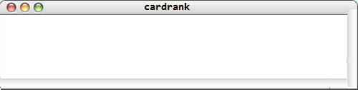
FIGURE 3-4 Main program from cardrank.c
main()
{
int n;
printf(“What is the rank of the card (1-13)? ”);
n = GetInteger();
switch (n) {
case 1: printf(“Ace\n”); break;
case 11: printf(“Jack\n”); break;
case 12: printf(“Queen\n”); break;
case 13: printf(“King\n”); break;
default: printf( “%d\n”,n); break;
}
}
What is the rank of the card (1-13)?

Slide 24
FIGURE 3-4 Main program from cardrank.c
main()
{
int n;
printf(“What is the rank of the card (1-13)? ”);
n = GetInteger();
switch (n) {
case 1: printf(“Ace\n”); break;
case 11: printf(“Jack\n”); break;
case 12: printf(“Queen\n”); break;
case 13: printf(“King\n”); break;
default: printf( “%d\n”,n); break;
}
}
What is the rank of the card (1-13)?
13

Slide 25
FIGURE 3-4 Main program from cardrank.c
main()
{
int n;
printf(“What is the rank of the card (1-13)? ”);
n = GetInteger();
switch (n) {
case 1: printf(“Ace\n”); break;
case 11: printf(“Jack\n”); break;
case 12: printf(“Queen\n”); break;
case 13: printf(“King\n”); break;
default: printf( “%d\n”,n); break;
}
}
What is the rank of the card (1-13)?
13
King

Slide 26
3.6 The while statement
Which repeatedly executes a simple statement or block until the conditional expression becomes FALSE .
SYNTAX for the while statements
while ( expression ) {
statements
}
The conditional test is performed before every cycle of the loop, including the first. If the test is FALSE initially, the body of the loop is not executed at all.
If that condition happens to become FALSE at some point during the loop, the program doesn’t notice that fact until a complete cycle has been executed. At that point, that program evaluates that test condition again. If it is still FALSE, that loop terminates.

Slide 27
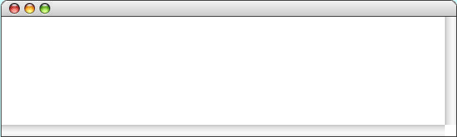

Using the while loop:The DigitSum Program
FIGURE 3-5 Main program from digitsum.c
mail() {
int n, dsum;
printf("This program sums the digits in an integer.\n");
printf("Enter a positive integer: ");
n = GetInteger();
dsum = 0;
while ( n > 0 ) {
dsum += n % 10;
n /= 10;
}
println("The sum of the digits is %d\n", dsum);
}
DigitSum
n
dsum

Slide 28
Using the while loop:The DigitSum Program
FIGURE 3-5 Main program from digitsum.c
mail() {
int n, dsum;
printf("This program sums the digits in an integer.\n");
printf("Enter a positive integer: ");
n = GetInteger();
dsum = 0;
while ( n > 0 ) {
dsum += n % 10;
n /= 10;
}
println("The sum of the digits is %d\n", dsum);
}
DigitSum
n
dsum
This program sums the digits in an integer.

Slide 29
Using the while loop:The DigitSum Program
FIGURE 3-5 Main program from digitsum.c
mail() {
int n, dsum;
printf("This program sums the digits in an integer.\n");
printf("Enter a positive integer: ");
n = GetInteger();
dsum = 0;
while ( n > 0 ) {
dsum += n % 10;
n /= 10;
}
println("The sum of the digits is %d\n", dsum);
}
DigitSum
n
dsum
This program sums the digits in an integer.
Enter a positive integer:

Slide 30
Using the while loop:The DigitSum Program
FIGURE 3-5 Main program from digitsum.c
mail() {
int n, dsum;
printf("This program sums the digits in an integer.\n");
printf("Enter a positive integer: ");
n = GetInteger();
dsum = 0;
while ( n > 0 ) {
dsum += n % 10;
n /= 10;
}
println("The sum of the digits is %d\n", dsum);
}
DigitSum
n
dsum
This program sums the digits in an integer.
1729
Enter a positive integer:
1729

Slide 31
Using the while loop:The DigitSum Program
FIGURE 3-5 Main program from digitsum.c
mail() {
int n, dsum;
printf("This program sums the digits in an integer.\n");
printf("Enter a positive integer: ");
n = GetInteger();
dsum = 0;
while ( n > 0 ) {
dsum += n % 10;
n /= 10;
}
println("The sum of the digits is %d\n", dsum);
}
DigitSum
n
dsum
This program sums the digits in an integer.
1729
0
Enter a positive integer:
1729

Slide 32
Using the while loop:The DigitSum Program
FIGURE 3-5 Main program from digitsum.c
mail() {
int n, dsum;
printf("This program sums the digits in an integer.\n");
printf("Enter a positive integer: ");
n = GetInteger();
dsum = 0;
while ( n > 0 ) {
dsum += n % 10;
n /= 10;
}
println("The sum of the digits is %d\n“, dsum);
}
DigitSum
n
dsum
This program sums the digits in an integer.
1729
0
9
Enter a positive integer:
1729

Slide 33
Using the while loop:The DigitSum Program
FIGURE 3-5 Main program from digitsum.c
mail() {
int n, dsum;
printf("This program sums the digits in an integer.\n");
printf("Enter a positive integer: ");
n = GetInteger();
dsum = 0;
while ( n > 0 ) {
dsum += n % 10;
n /= 10;
}
println("The sum of the digits is %d\n",dsum);
}
DigitSum
n
dsum
This program sums the digits in an integer.
1729
9
Enter a positive integer:
172
1729

Slide 34
Using the while loop:The DigitSum Program
FIGURE 3-5 Main program from digitsum.c
mail() {
int n, dsum;
printf("This program sums the digits in an integer.\n");
printf("Enter a positive integer: ");
n = GetInteger();
dsum = 0;
while ( n > 0 ) {
dsum += n % 10;
n /= 10;
}
println("The sum of the digits is %d\n", dsum);
}
DigitSum
n
dsum
This program sums the digits in an integer.
1729
11
172
9
Enter a positive integer:
1729

Slide 35
Using the while loop:The DigitSum Program
FIGURE 3-5 Main program from digitsum.c
mail() {
int n, dsum;
printf("This program sums the digits in an integer.\n");
printf("Enter a positive integer: ");
n = GetInteger();
dsum = 0;
while ( n > 0 ) {
dsum += n % 10;
n /= 10;
}
println("The sum of the digits is %d\n", dsum);
}
DigitSum
n
dsum
This program sums the digits in an integer.
1729
11
17
9
Enter a positive integer:
172
1729

Slide 36
Using the while loop:The DigitSum Program
FIGURE 3-5 Main program from digitsum.c
mail() {
int n, dsum;
printf("This program sums the digits in an integer.\n");
printf("Enter a positive integer: ");
n = GetInteger();
dsum = 0;
while ( n > 0 ) {
dsum += n % 10;
n /= 10;
}
println("The sum of the digits is %d\n", dsum);
}
DigitSum
n
dsum
This program sums the digits in an integer.
1729
11
17
9
Enter a positive integer:
172
18
1729

Slide 37
Using the while loop:The DigitSum Program
FIGURE 3-5 Main program from digitsum.c
mail() {
int n, dsum;
printf("This program sums the digits in an integer.\n");
printf("Enter a positive integer: ");
n = GetInteger();
dsum = 0;
while ( n > 0 ) {
dsum += n % 10;
n /= 10;
}
println("The sum of the digits is %d\n", dsum);
}
DigitSum
n
dsum
This program sums the digits in an integer.
1729
11
1
9
17
18
Enter a positive integer:
172
1729

Slide 38
Using the while loop:The DigitSum Program
FIGURE 3-5 Main program from digitsum.c
mail() {
int n, dsum;
printf("This program sums the digits in an integer.\n");
printf("Enter a positive integer: ");
n = GetInteger();
dsum = 0;
while ( n > 0 ) {
dsum += n % 10;
n /= 10;
}
println("The sum of the digits is %d\n", dsum);
}
DigitSum
n
dsum
This program sums the digits in an integer.
1729
11
1
9
17
18
Enter a positive integer:
172
19
1729

Slide 39
Using the while loop:The DigitSum Program
FIGURE 3-5 Main program from digitsum.c
mail() {
int n, dsum;
printf("This program sums the digits in an integer.\n");
printf("Enter a positive integer: ");
n = GetInteger();
dsum = 0;
while ( n > 0 ) {
dsum += n % 10;
n /= 10;
}
println("The sum of the digits is %d\n", dsum);
}
DigitSum
n
dsum
This program sums the digits in an integer.
1729
11
0
9
1
17
18
Enter a positive integer:
172
19
1729

Slide 40
Using the while loop:The DigitSum Program
FIGURE 3-5 Main program from digitsum.c
mail() {
int n, dsum;
printf("This program sums the digits in an integer.\n");
printf("Enter a positive integer: ");
n = GetInteger();
dsum = 0;
while ( n > 0 ) {
dsum += n % 10;
n /= 10;
}
printf ("The sum of the digits is %d\n", dsum);
}
DigitSum
n
dsum
This program sums the digits in an integer.
1729
11
0
9
1
17
18
Enter a positive integer:
172
19
1729
The sum of the digits is 19.

Slide 41


If you carelessly write the while loop in the digisum.c program with a >= operator in the control line, what will happen?
Infinite loops
mail() {
int n, dsum;
printf("This program sums the digits in an integer.\n");
printf("Enter a positive integer: ");
n = GetInteger();
dsum = 0;
while ( n >= 0 ) {
dsum += n % 10;
n /= 10;
}
println("The sum of the digits is %d\n", dsum);
}
what will happen?
This loop will never stop running.

Slide 42

Solving the loop-and-a-half problem
The while loop is designed for situations in which there is some test condition that can be applied at the beginning of a repeated operation.
Some problems are structured in such a way that the test you would like to write to determine if the loop is complete falls most naturally somewhere in the middle of the loop.
EXAMPLE The sentinel-based loop (loop-and-a-half problem)
1. Read in a value.
2. If the value is equal to the sentinel, exit form the loop.
3. Perform whatever processing is required for that value.
One way to solve the loop-and-a-half problem in C is to use the break statement .
while (TRUE)) {
prompt user and read in a value
If (value == sentinel) break;
process the data value
}

Slide 43

Solving the loop-and-a-half problem
It is possible to code this sort of loop without using the while (TRUE) control line or the break statement.
Change the order of operations within the loop and request input data in two places.
prompt user and read in the first value
while (value!= sentinel) {
process the data value
prompt user and read in a new value
}

Slide 44
Solving the loop-and-a-half problem
FIGURE 3-6 Revise main program from addlist.c
mail()
{
int value, total;
printf(“This program adds a list of numbers.\n”);
pirntf(“Signal end of list with a 0.\n”);
total = 0;
printf(“ ? “);
value = GetInteger();
while (value != 0) {
total += value;
pirntf(“ ? “);
value = GetInteger();
}
printf(“The total is %d\n”, total);
}

Slide 45
3.7 The for statement
Which is most often used in situation s in which you want to repeat an operation a particular number of times.
SYNTAX for the for statements
for ( init ; test ; step ) {
statements
}
The init expression indicates how the for loop should be initialized and usually sets the initial value of the index variable.
The test expression is a conditional test. As long as the test expression is TRUE, the loop continues.
The step expression indicates how the value of the index variable changes from cycle to cycle.

Slide 46



The relationship between for and while
The for statement
for ( init ; test ; step ) {
statements to be repeated
}
is functionally equivalent to the following code using while:
init;
while ( test ) {
statements to be repeated
step;
}
The advantage of the for statement is that everything you need to know to understand how many times the loop will run is explicitly included in the header line.

Slide 47
Describe the effect of each of the following for statements:
1.
for (i = 1; i <= 10; i++)
Executes the loop body ten times, with the control variable i taking on each successive value between 1 and 10.
2.
for (i = 0; i < N; i++)
Executes the loop body N times, with i counting from 0 to N-1. This version is the standard Repeat-N-Times idiom.
3.
for (n = 99; n >= 1; n -= 2)
This statement counts backward from 99 to 1 by twos.
4.
for (x = 1; x <= 1024; x *= 2)
Executes the loop body with the variable x taking on successive powers of two from 1 up to 1024.

Slide 48
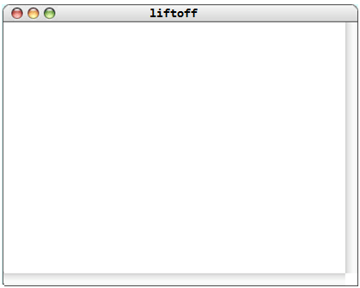
FIGURE 3-7 liftoff.c
/* simulates a countdown for a rocket launch. */
#include <stdio.h>
#include “genlib.h”
/* Constant: StartingCount */
#define StartingCount 10
/* Main program */
main()
{
int t;
for (t = StartingCount; t >= 0; t--) {
printf(“%2d\n”, t);
}
printf(“Liftoff!\n”);
}
10
9
8
7
6
5
4
3
2
1
0
Liftoff!

Slide 49
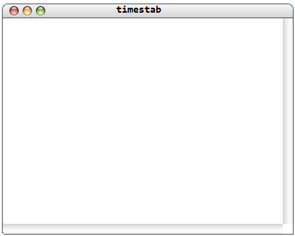
Nested for loops
FIGURE 3-8 timestab.c
/* File: timestab.c */
/* Generates a multiplication table where each axis
runs form LowerLimit to UpperLimit. */
#include <stdio.h>
#include “genlib.h”
/* Constants
LowerLimit – Starting value for the table
UpperLimit – Final value for the table
*/
#define LowerLimit 1
#define UpperLimit 10
mainn()
{
int i, j;
for (i = LowerLimit; i<= UpperLimit; i++) {
fro (j = LowerLimit; j <= UpperLimit; j++) {
printf(“ %4d”, i * j);
}
printf(“\n”);
}
}
1 | 2 | 3 | 4 | 5 | 6 | 7 | 8 | 9 | 10
2 | 4 | 6 | 8 | 10 | 12 | 14 | 16 | 18 | 20
3 | 6 | 9 | 12 | 15 | 18 | 21 | 24 | 27 | 30
4 | 8 | 12 | 16 | 20 | 24 | 28 | 32 | 36 | 40
5 | 10 | 15 | 20 | 25 | 30 | 35 | 40 | 45 | 50
6 | 12 | 18 | 24 | 30 | 36 | 42 | 48 | 54 | 60
7 | 14 | 21 | 28 | 35 | 42 | 49 | 56 | 63 | 70
8 | 16 | 24 | 32 | 40 | 48 | 56 | 64 | 72 | 80
9 | 18 | 27 | 36 | 45 | 54 | 63 | 72 | 81 | 90
10 | 20 | 30 | 40 | 50 | 60 | 70 | 80 | 90 | 100

Slide 50


Using for with floating-point data
The for loop:
for ( x = 1.0 ; x <= 2.0 ; x += 0.1 ) {
printf( “%.1f\n”, x );
}
This loop might not include the value 2.0.
for ( i = 10 ; i <= 20 ; i++ ) {
x = i / 10.0;
printf( “%.1f\n”, x );
}
This for loop correctly produces the 11 values in the sequence 1.0,1.1,1.2,…,2.0.

Slide 51
The End

